Slide 1
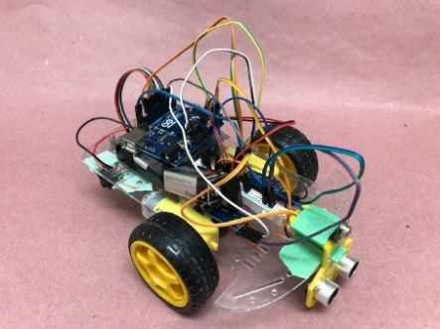
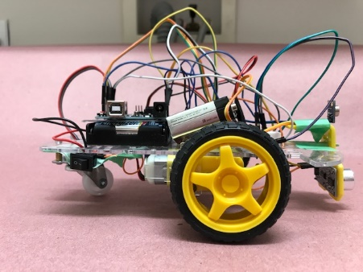
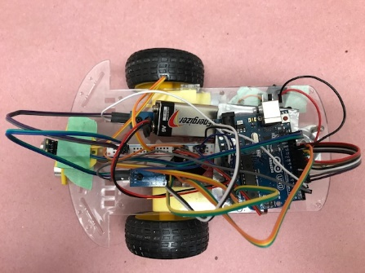
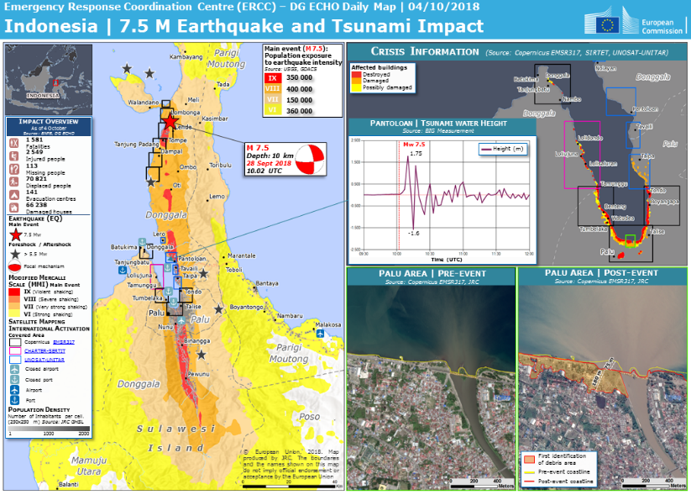
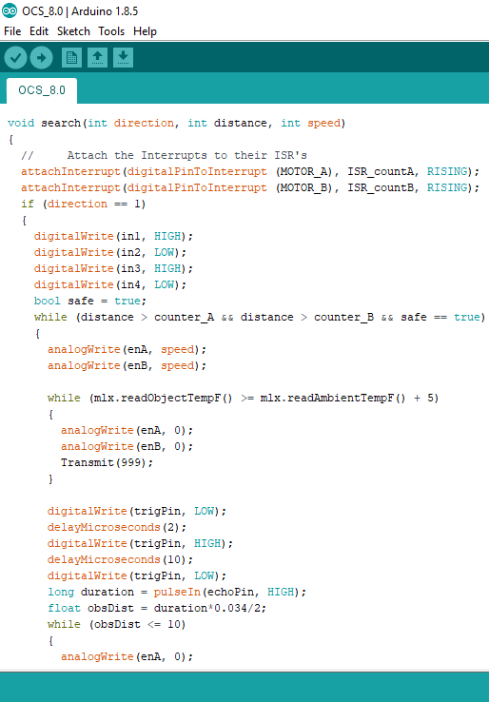
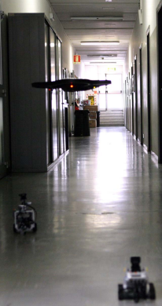
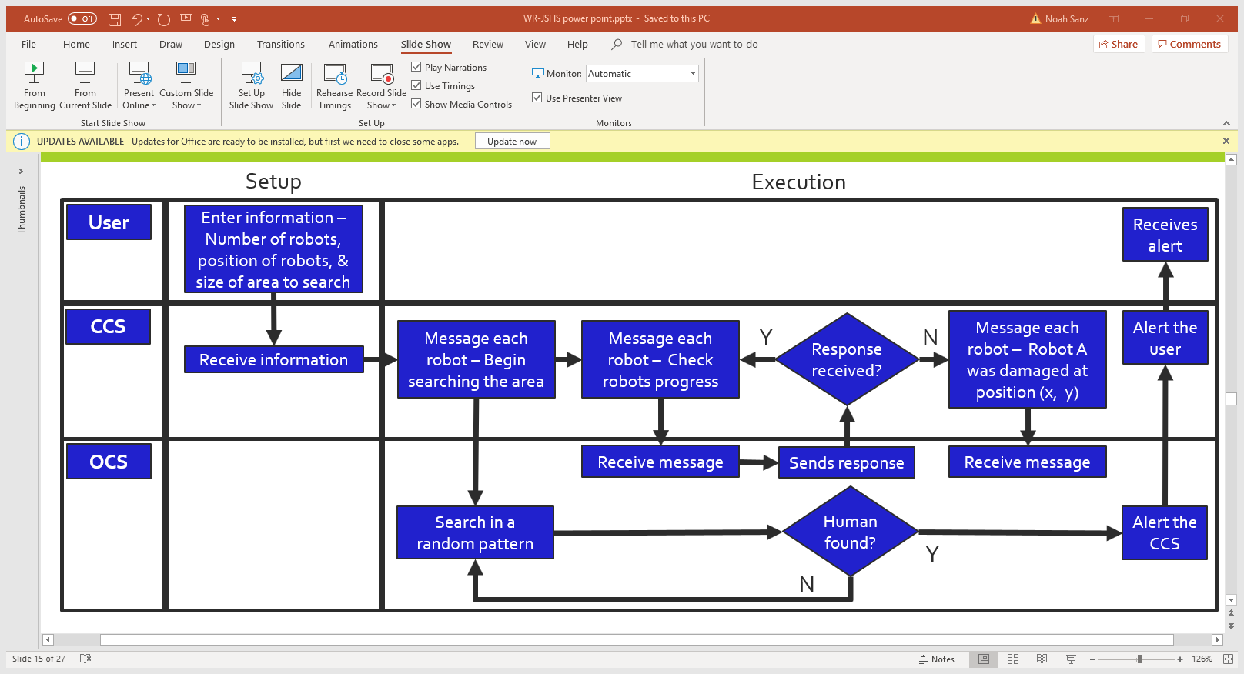
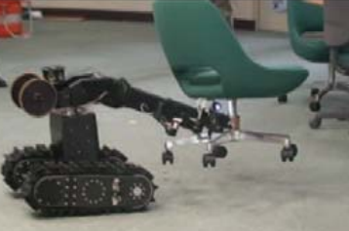
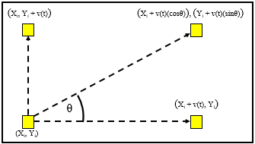
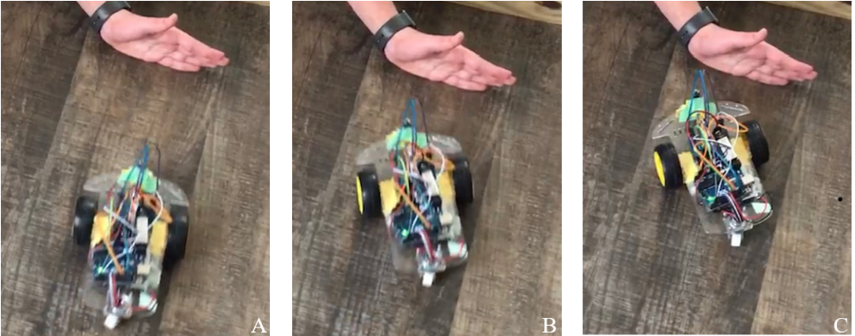
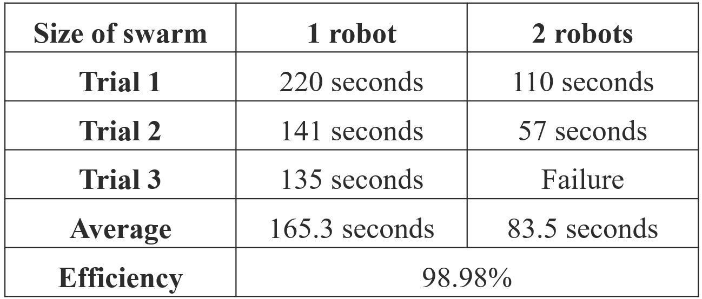
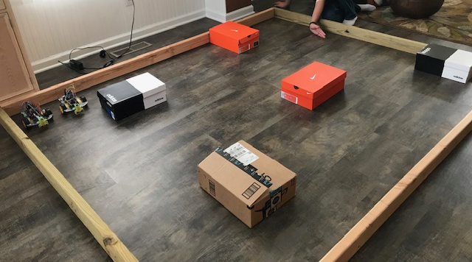
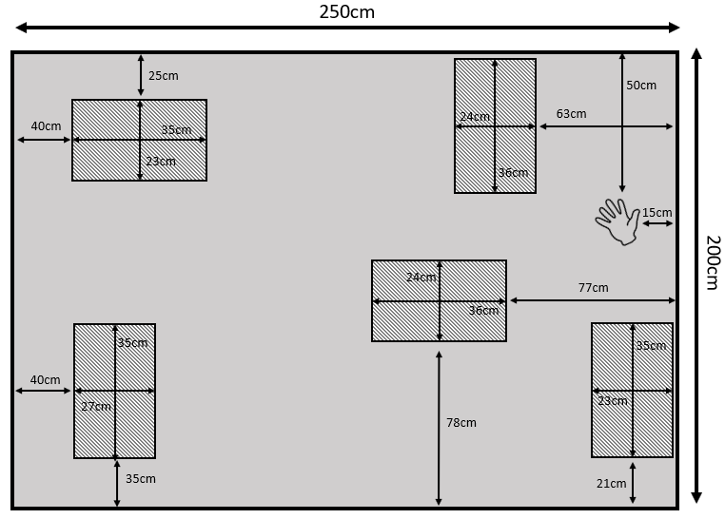
Using an Autonomous Swarm Robot Team to Locate Survivors in a Dangerous Area
Introduction
The Hardware
9/28/18 – Earthquake and Tsunami hit Indonesia
10/5/18 – Over 1000 people remain missing
The Body
The Onboard Control System
The Arduino Uno
The Power Supply
One 9V battery
Four AA batteries
The Communication System
The Radio tranceiver
Two DC Gear Motors
Speed Sensors
The Sensor Panel
The Obstacle Detection System
The Ultrasonic Sensor
The Human Detection System
The IR Temperature Sensor
https://www.thenational.ae/world/asia/number-of-missing-soars-one-week-after-earthquake-and-tsunami-on-indonesia-s-sulawesi-island-1.777463#7
Image by Noah Sanz
Image by Noah Sanz
Image by Noah Sanz
http://www.gdacs.org/maps.aspx?eventid=1157757&eventtype=EQ
https://www.thenational.ae/world/asia/number-of-missing-soars-one-week-after-earthquake-and-tsunami-on-indonesia-s-sulawesi-island-1.777463#7
Review of Literature
Better for searching large or dangerous areas
Robustness, flexibility, and scalability are important properties of swarm robots (Sahin, 2005)
The HELIOS system (Guarnieri et al., 2009) and the Multi-Robot Search and Rescue Team (Luo, Espinosa, Pranantha, & De Gloria 2011) are examples of swarm robot teams that are used for search and rescue.
Image by Noah Sanz
The Software
Robot System | HELIOS | Multi-Robot Search and Rescue Team
Able to search unknown environment
Low cost and expendable
Autonomous
The CCS is the interface between the user and the robots
The CCS supervises all of the robots in the system
The OCS controls the robots movement, sensing, and communication with the CCS
(Luo, Espinosa, Pranantha, & De Gloria 2011)
Obstacle Sensing
As the robot approaches an obstacle, it detects it and stops (A and B)
Then, it turns away from the obstacle (C and D)
Finally, it drives away (E and F)
Human Detection
As the robot approaches a human, it detects it and stops (A)
Then, it moves in closer (B)
Finally, it stops and sends a signal to the CCS (C)
Image by Noah Sanz
(Guarnieri et al., 2009)
Positioning
The robots use dead reckoning for positioning
As the robot drives, the speed sensors determine the velocity of each wheel
Using 1D motion equations the robot can determine its new position relative to the starting position
Objectives
Create and test a simple and low-cost swarm robot system that is capable of searching an unknown environment for human life without any external assistance
Have the system be able to search 1m² in 60s or less
Have the system achieve at least 90% efficiency
Images by Noah Sanz
$$E=\frac{t_{s}}{t_{m}×n}×100\%$$
Images by Noah Sanz
Data
Six tests were carried out to examine the systems ability
During all six experiments the room size and shape were held constant as a 2.5m by 2m rectangle, as was the number and size of the obstacles and humans present.
Half of the tests were carried out with a single robot and half were carried out with a swarm of two robots.
Each experiment was carried out three times for replicate data and the completion times were recorded.
The completion time is the amount of time that the robot or robots took to locate the human.
If the robots search the entire environment without finding the human, the test is recorded as a failure.
Image by Noah Sanz
The robot system found the human in five out of six experiments (83.3%)
The single robot searched the 2.5m by 2m area in an average of 165.3 seconds
This is an average of 33.06 seconds to search 1m²
The system had an efficiency of 98.98%
Discussion
Future Research
The low cost of the robots allow them to be more expendable and more useful for dangerous environments
The high efficiency makes the system scalable
This would allow large systems of robots to be produced at a low cost and be able to search an unknown environment efficiently
Future research will focus on a more accurate positioning system that is low cost and capable of working indoors
This may be achieved through trilateration
It will also focus on development of a simulator to discover better search processes
Conclusion
I was successfully able to create a low-cost simple robot system capable of searching an unknown environment for human life
The system was able to achieve its speed goals by searching 1m² in an average of 33.06 seconds
The system was able to achieve its efficiency goal with an efficiency of 98.98%
Dead reckoning is subject to more error than other positioning methods especially when using DC motors or on uneven ground
IR temperature sensors are unable to determine the difference between a human and another hot object
Images by Noah Sanz

