Slide 1
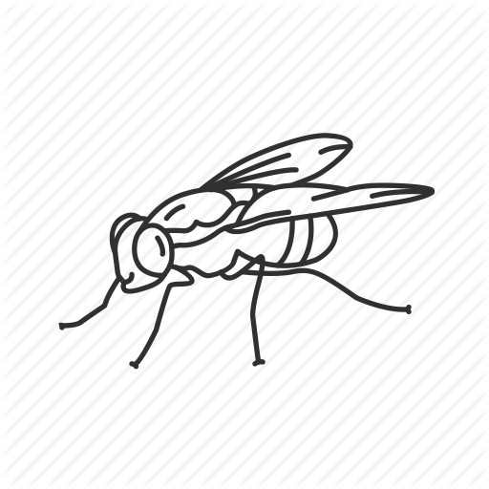
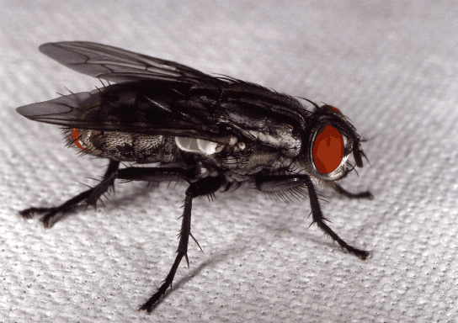
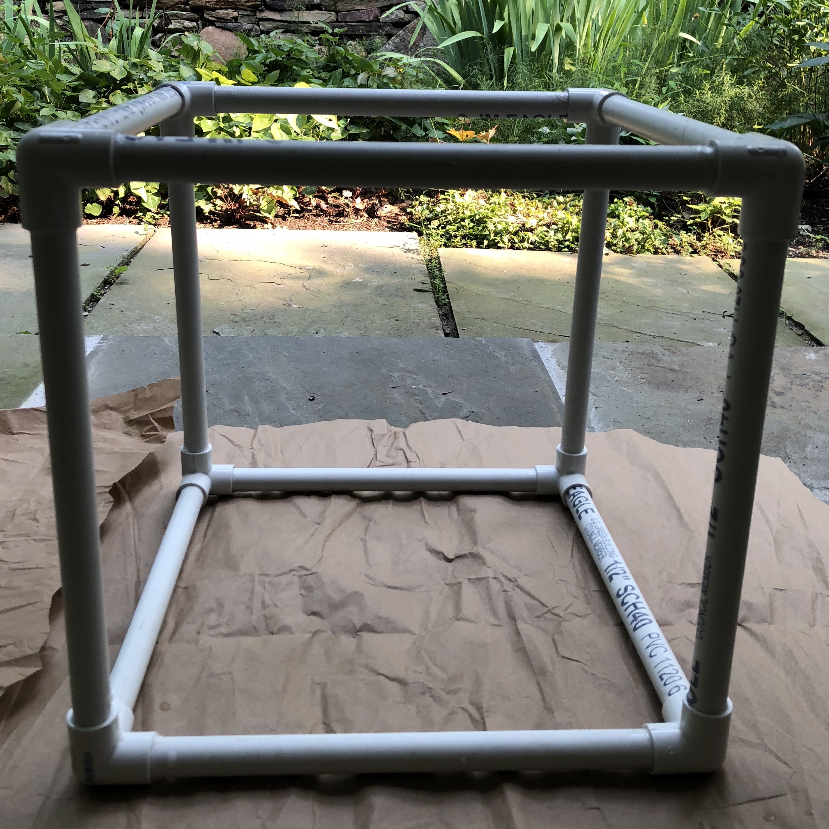
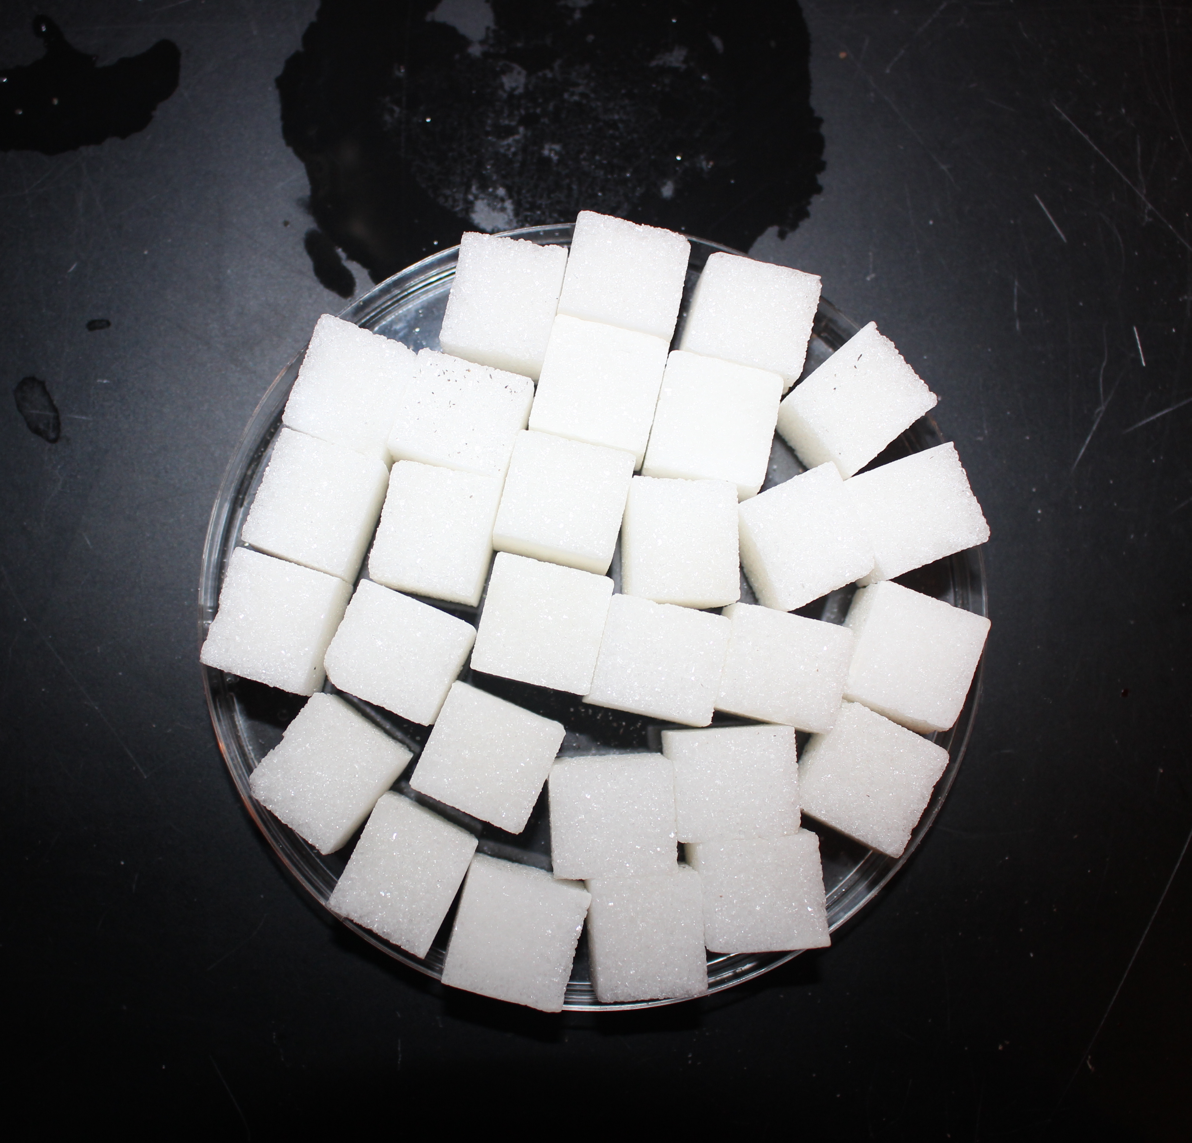
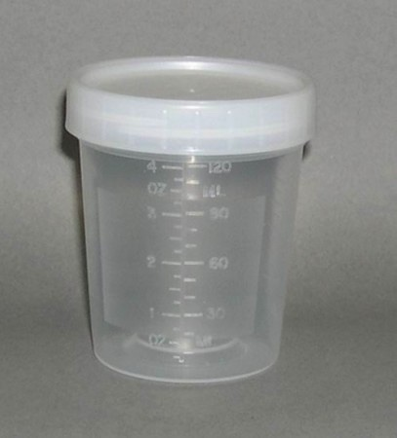
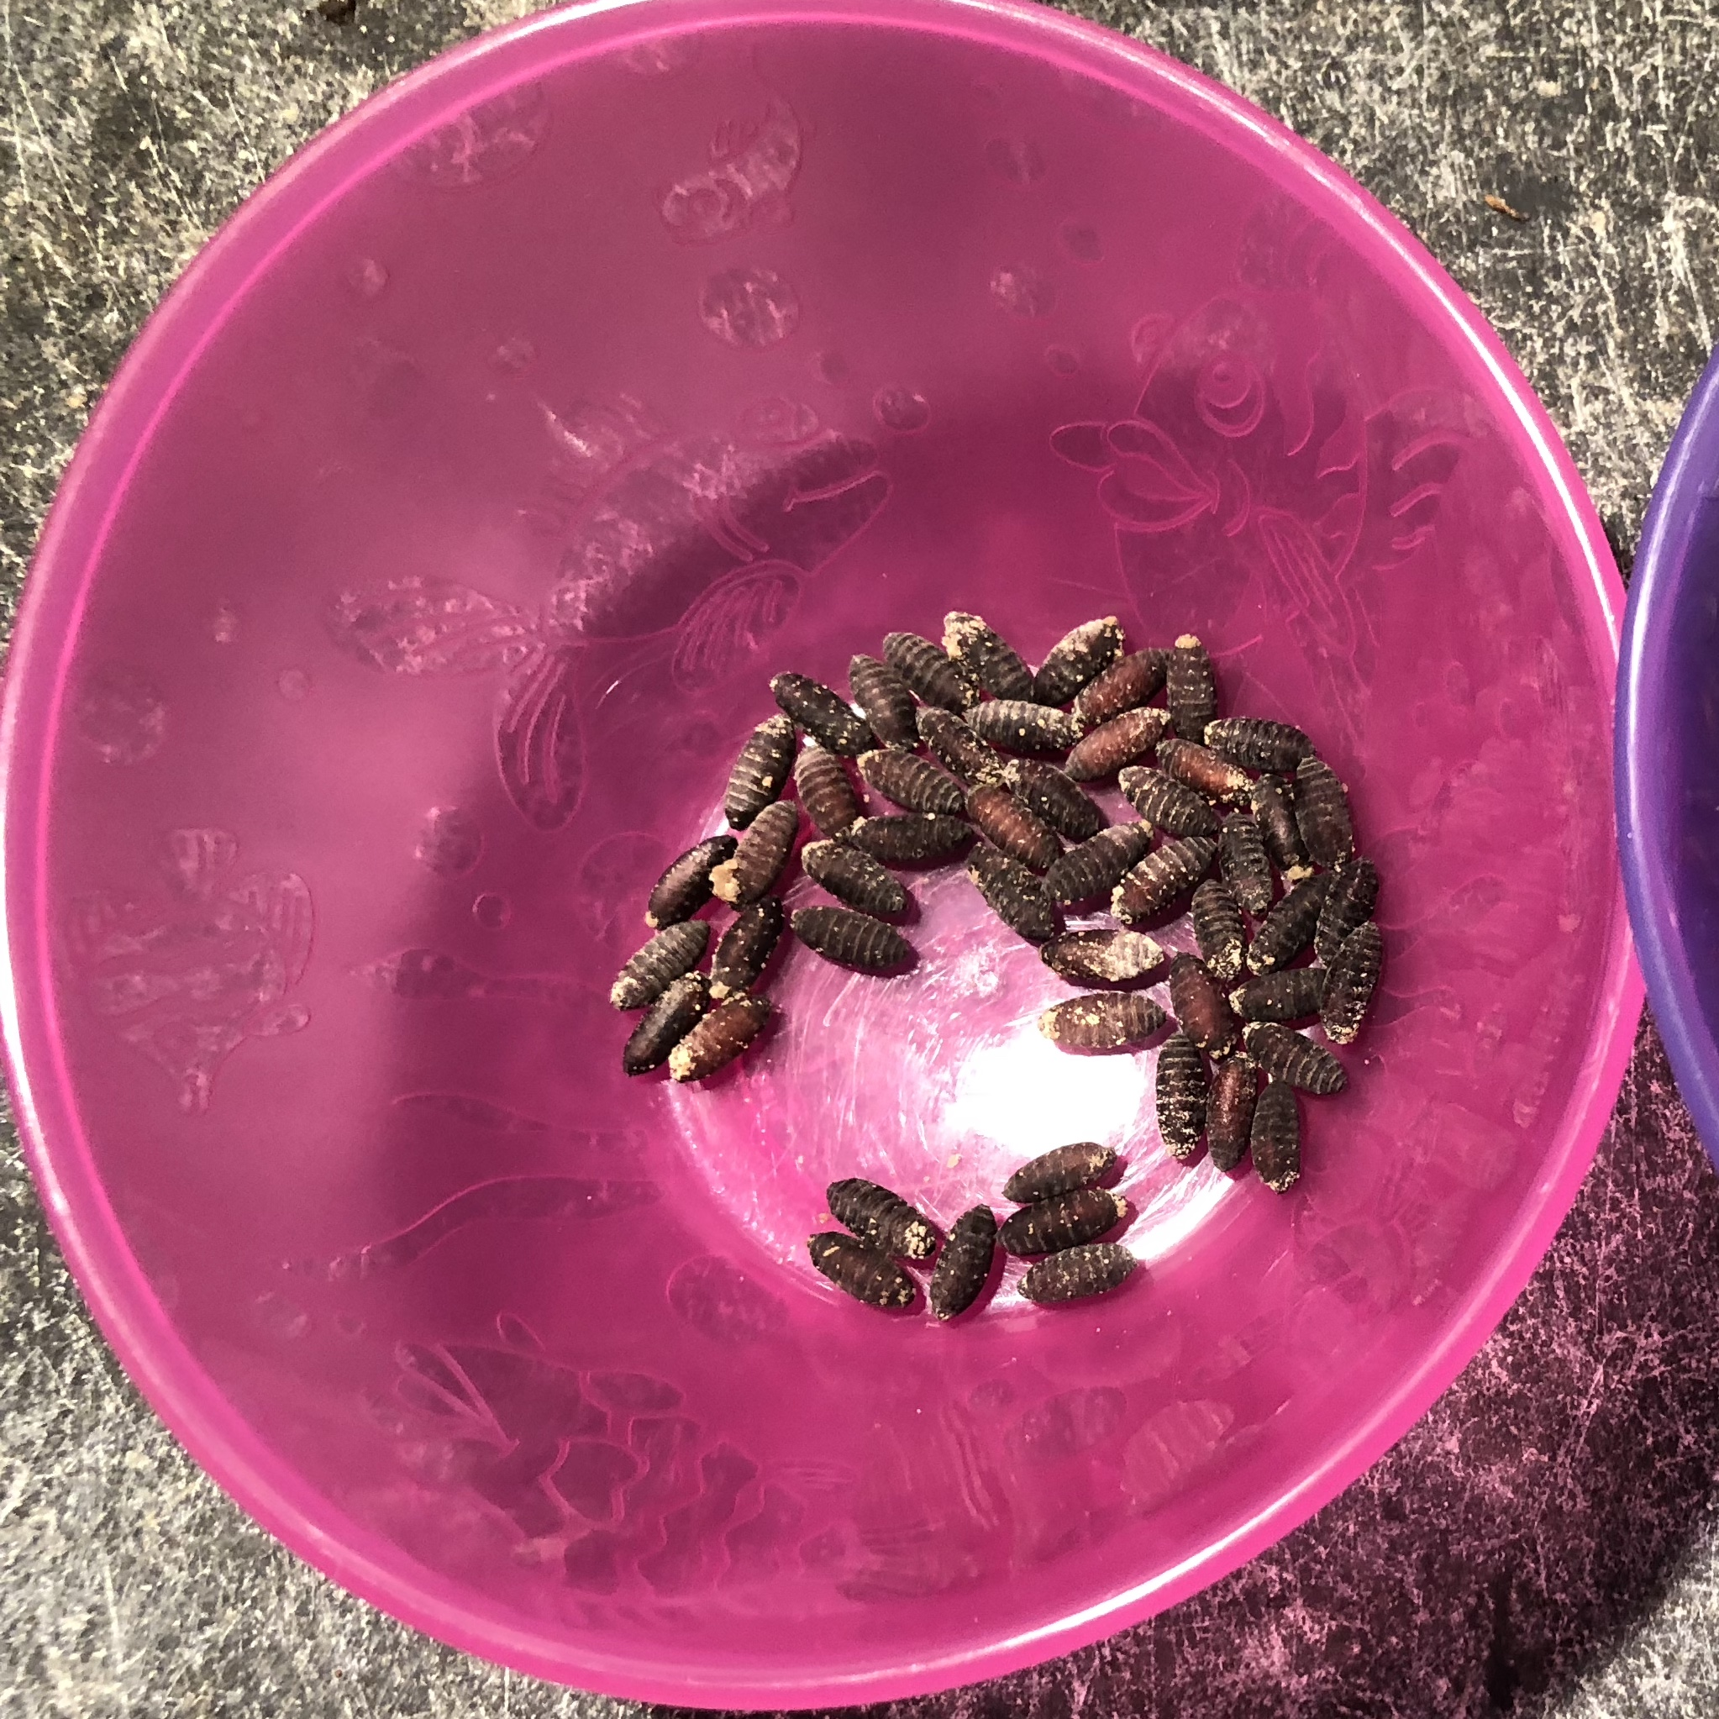
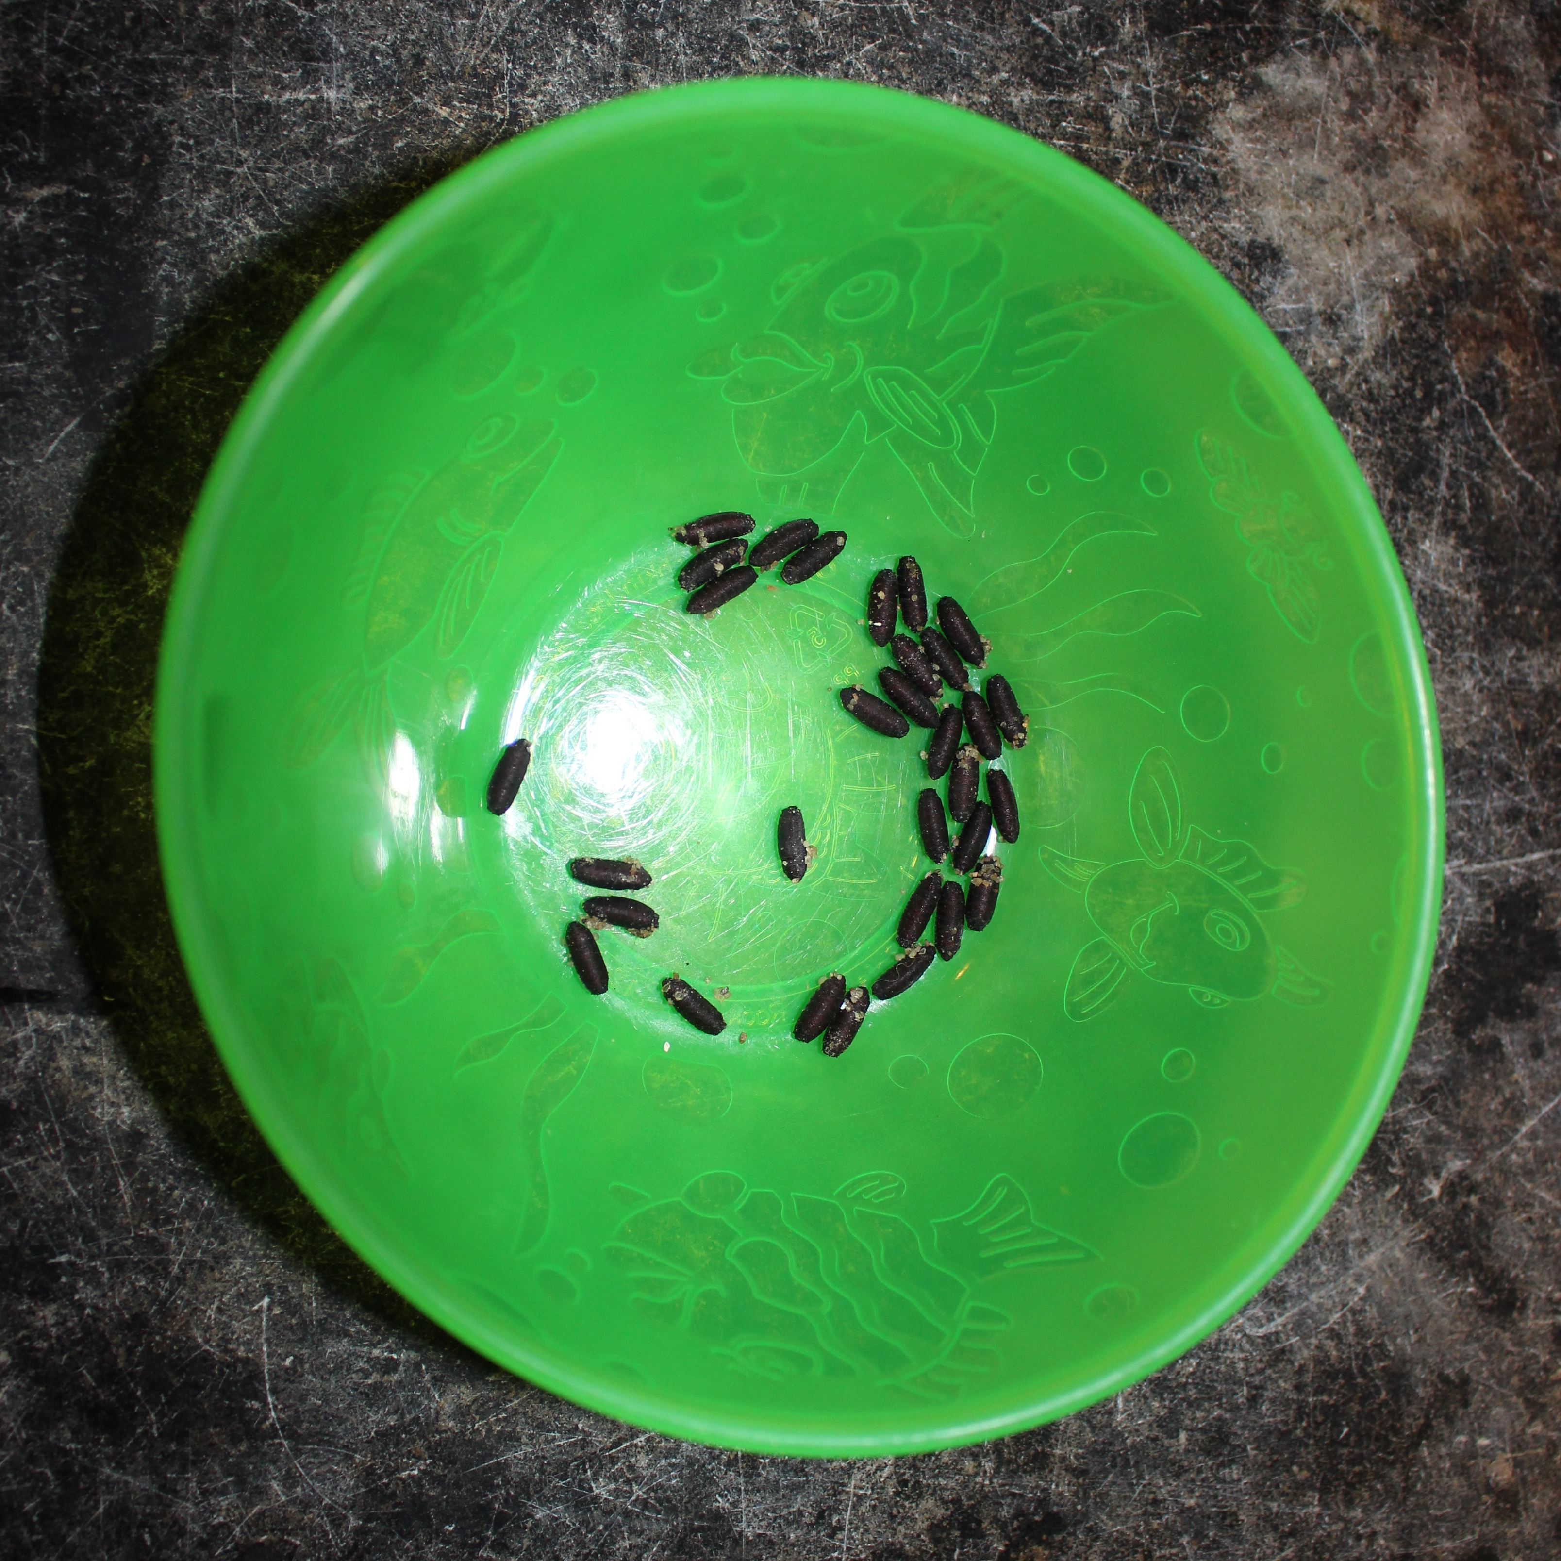
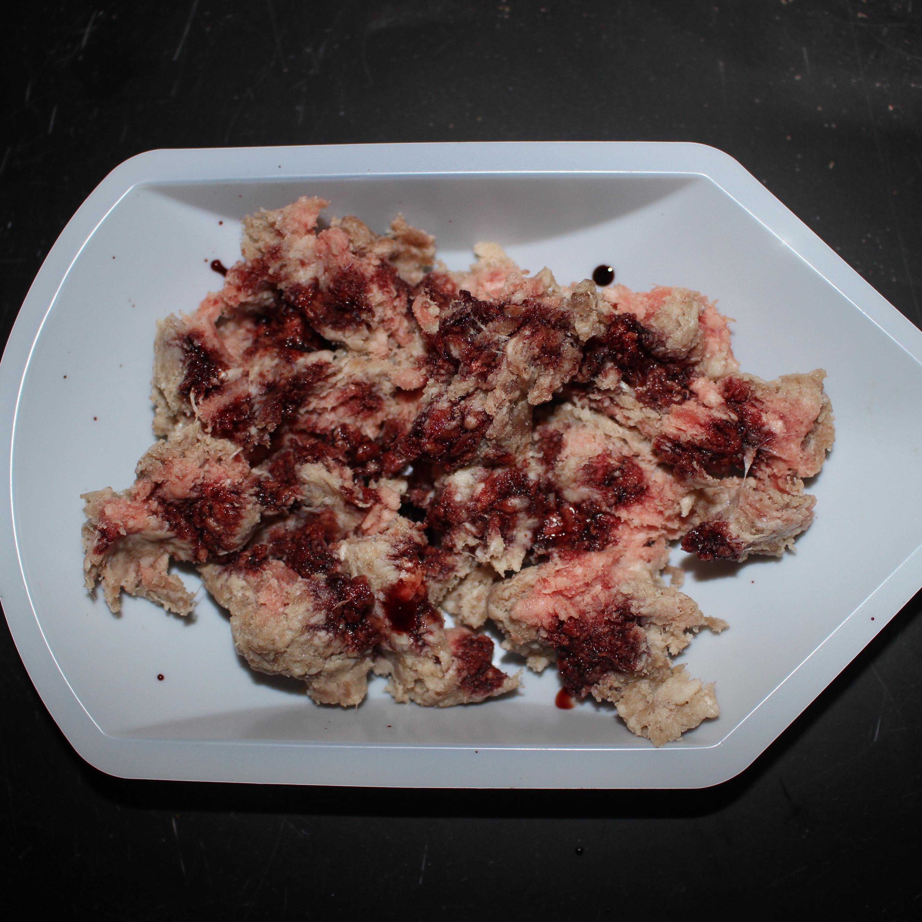
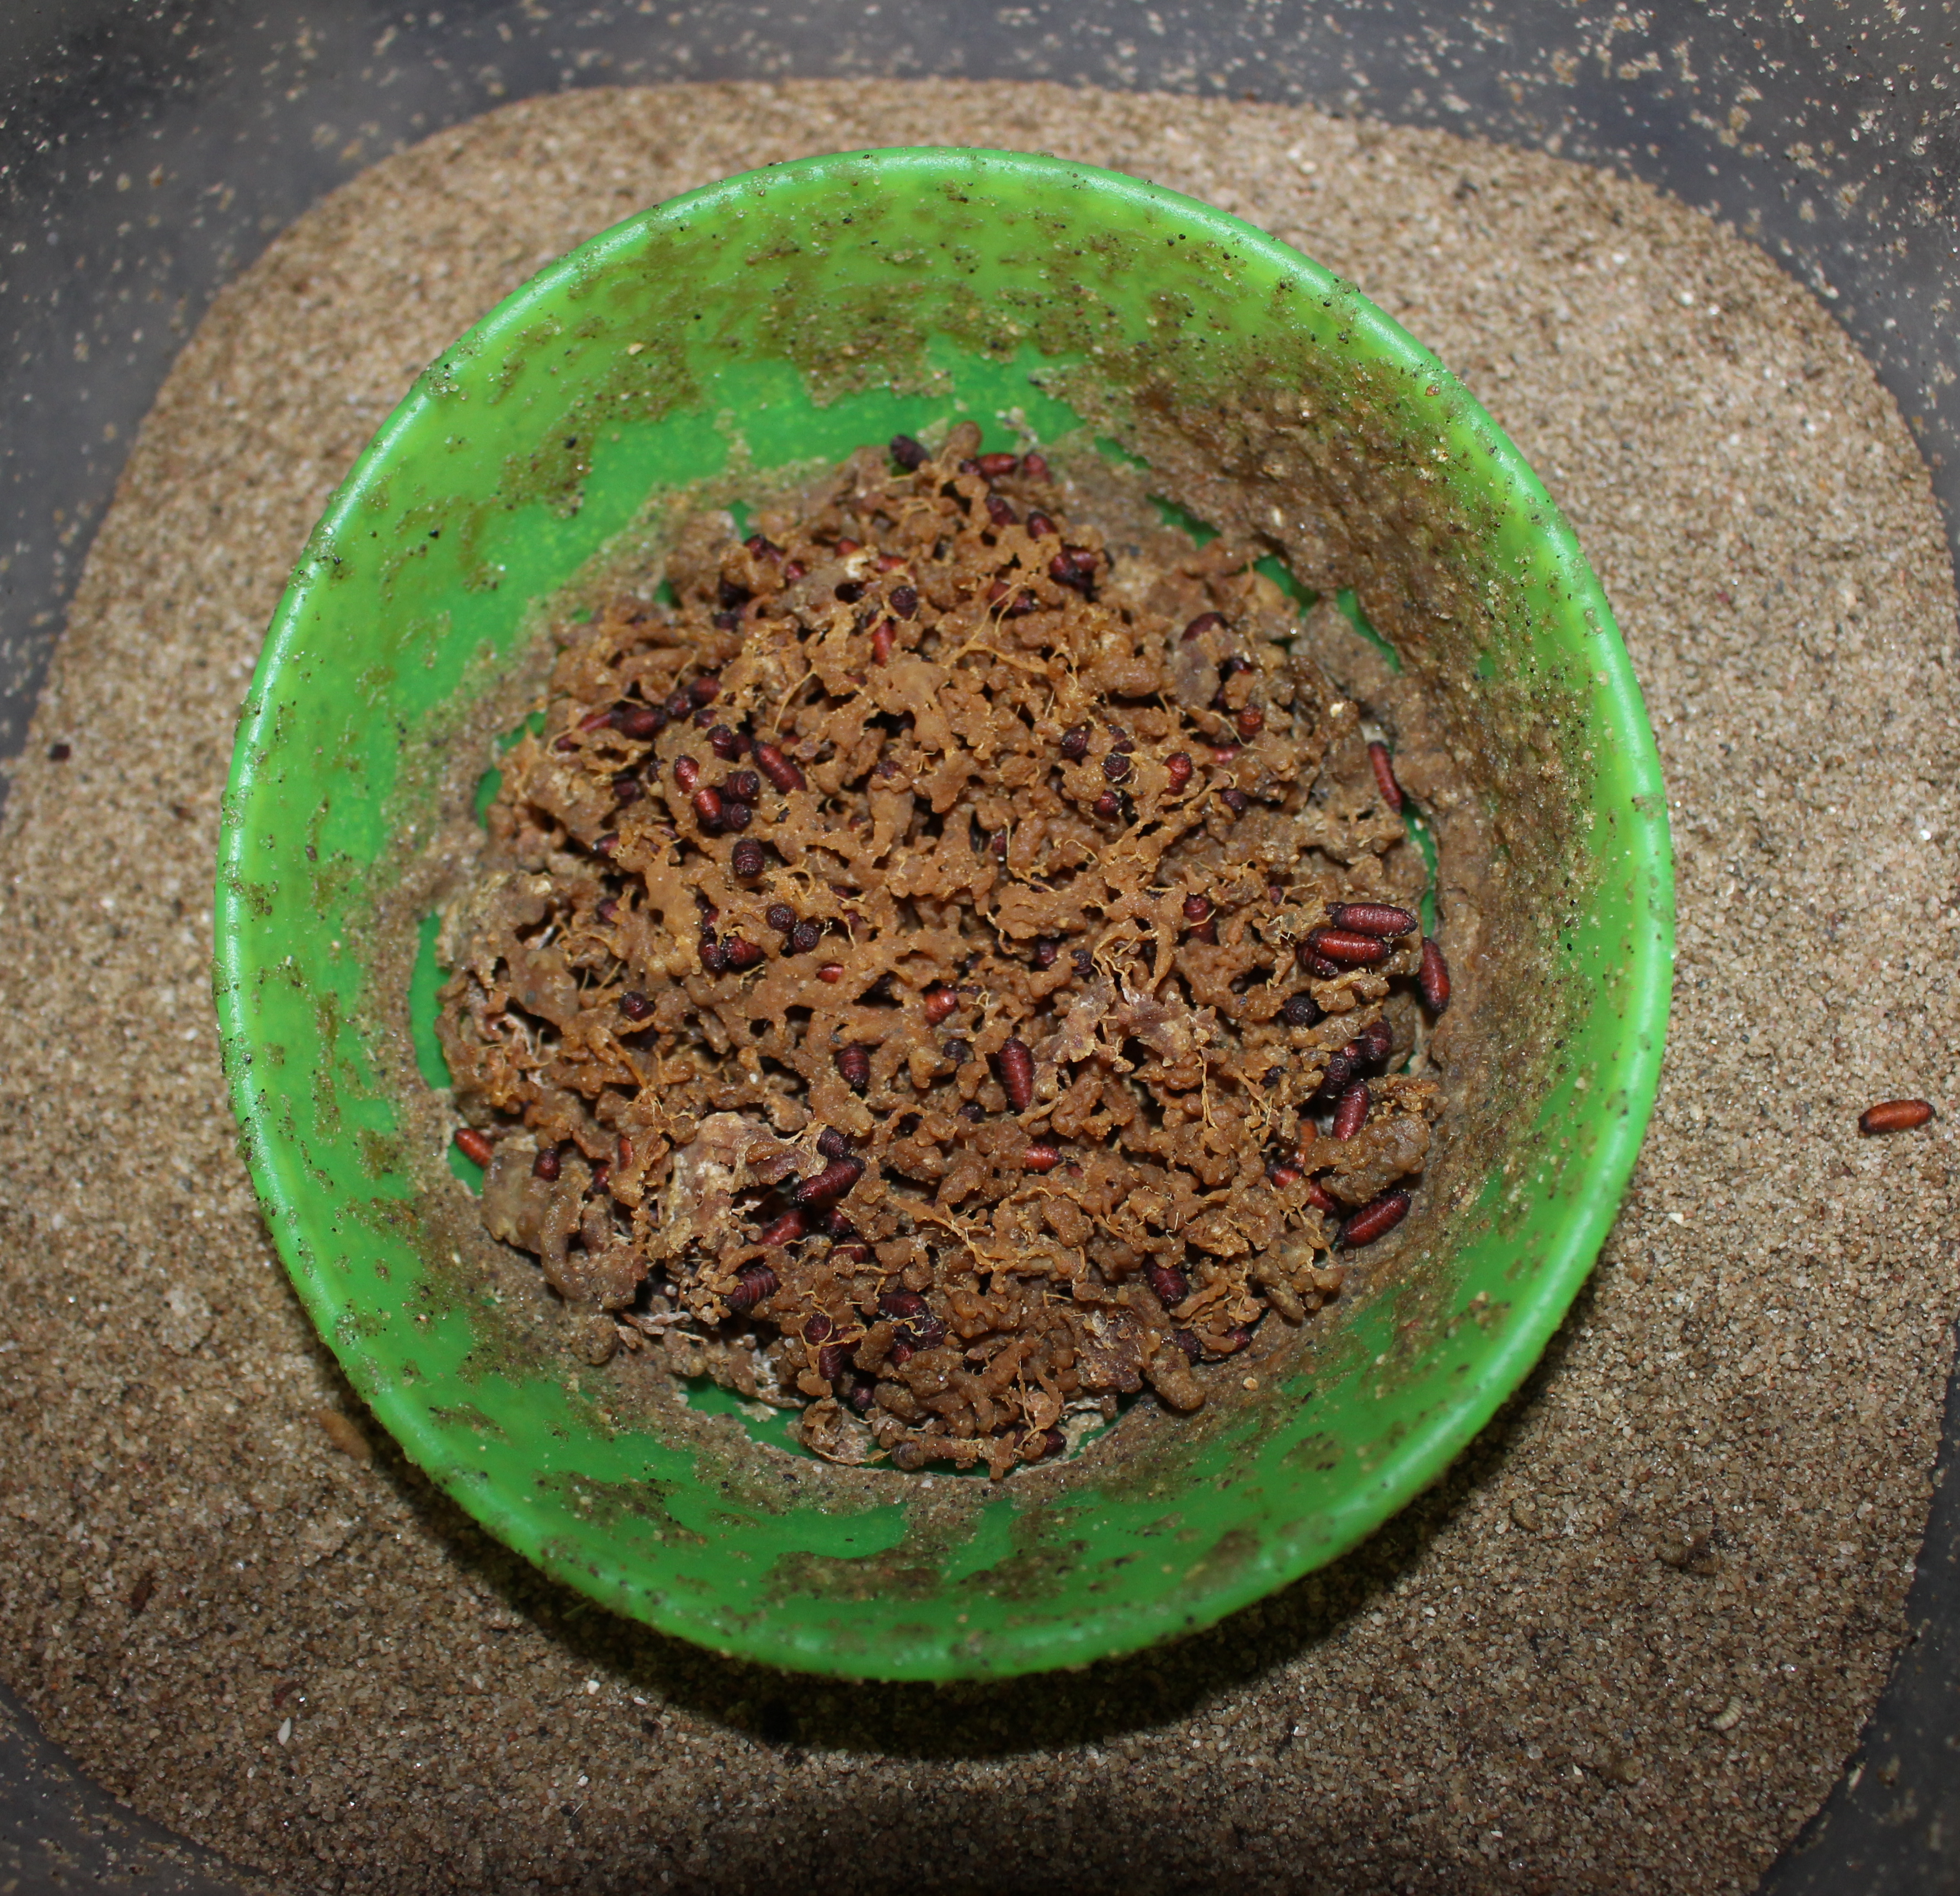
Differential Decomposition of a Single Diptera Species (Sarcophagidae) versus a Community of Diptera Species (Calliphoridae)
Emma Jones and Chelsea Brown
Introduction
Review of Literature
Forensic Diptera Entomology:
The process of studying the insects and arthropods on decomposing carcasses for legal and scientific purposes.
Post-mortem Interval (PMI):
The interval of time after death that helps entomologists determine how long a carcass has been decomposing by flies.
Larvae require live or dead animal tissue to complete their life cycle (Watson & Dallwitz 2003, Byrd & Castner 2001)
Competition between flies has a direct impact on which fly lays more on a carcass (Denno 2011)
Maggot size is affected by the number of maggots present on the carcass (Rivers, 2010)
Sarcophagidae
Calliphoridae
Larviparous:
Eggs develop internally and females birth live larvae.
The species Sarcophaga bullata is what makes up the single species sample.
Sarcophaga bullata
Oviparous:
Eggs are laid and hatch larvae outside of the body.
A mixture of species makes up the community sample, or Wildlife.
Phormia regina
Objectives
Determine the average decomposition of single species (Sarcophaga bullata).
Determine the average decomposition of the Wildlife community species (Calliphoridae).
Compare the average decomposition of the single versus community species.
http://labs.csb.utoronto.ca/tobe/neobellieria.shtml
https://www.opsu.edu
Representative of a lab setting testing a single species.
Representative of a natural setting with mix of species.
H₁ The single species, Sarcophaga bullata, will have a faster rate of decomposition than the community of Calliphoridae (Wildlife).
Hypothesis
H₀ There will be no statistically significant difference in decomposition rates between the single species, Sarcophaga bullata, and the community of Calliphoridae (Wildlife) species.
Fly Cage
Methodology
Rearing Dish
Sugar Cubes
Water Cup
s. Bullata Pupae
Wildlife Pupae
Blood Feed
Fly Maintenance
Photos by Emma Jones and Chelsea Brown
Rearing Dishes
Visited lab once a week to ensure health of survival of flies.
Began by building fly cages.
20 wildlife pupae placed into one cage, 20 S. bullata pupae placed into another cage.
Water cups and sugar cubes used to sustain life and help evolve flies.
Replaced weekly.
Blood Feeds
Blood feeds performed weekly.
Helped mature the flies into adult stages and provide them with a proper environment to lay their eggs and larvae on.
Used organs of fawn or pig with 2-3 drops of liquid blood placed over.
Performed 2-3 times until flies fully matured.
Rearing dishes only occur once flies are fully matured.
Similar to blood feed performed with mince.
Place bowl of mince into respective fly cages, and remove after 24 hours.
Place into rearing dish.
Allow to sit for two weeks before removing.
Results
Wildlife weights and decomposition of community species (Calliphoridae) trials.
Single species weights and decomposition of single species (Sarcophagidae) trials.
Weight (kg) | Trial #1 | Trial #2 | Trial #3 | Trial #4 | Trial #5 | Trial #6 | Trial #7
Before Feeding | 0.185 kg | 0.170 kg | 0.155 kg | 0.160 kg | 0.145 kg | 0.160 kg | 0.135 kg
After Feeding | 0.135 kg | 0.155 kg | 0.145 kg | 0.120 kg | 0.100 kg | 0.100 kg | 0.080 kg
Difference | 0.050 kg | 0.015 kg | 0.010 kg | 0.040 kg | 0.045 kg | 0.060 kg | 0.055 kg
Percent Decomposed | 27.0% | 8.8% | 6.5% | 25.0% | 31.0% | 37.5% | 40.7%
Weight (kg) | Trial #1 | Trial #2 | Trial #3
Before Feeding | 0.180 kg | 0.160 kg | 0.155 kg
After Feeding | 0.125 kg | 0.100 kg | 0.120 kg
Difference | 0.055 kg | 0.060 kg | 0.035 kg
Percent Decomposed | 30.5% | 37.5% | 22.6%
Average percent decomposed: 25.2%
Average percent decomposed: 30.2%
Discussion
Conclusion
The single species decomposed 5% more than the community sample.
There is statistical significance that both the single and community samples decomposed mince.
This shows that both samples decompose.
There is no statistically significant difference between the single and community samples.
Limitations:
Changing temperatures and seasons.
Not regulating initial weights of mince.
Fly maintenance.
Failed to reject null hypothesis that there is not a statistically significant difference between the decomposition rates of a single Diptera species versus a community of Diptera species.
This is effective information for entomologists because their research can be conducted within a controlled laboratory setting and produce the same results as an outdoor field environment would.
Future Work
Change a few aspects of this research in attempt to find different results:
Regulate the initial weight before decomposition creating another constant.
Create a new experiment with similar ideas:
Analyze how one species reacts in an isolated environment versus how it reacts in an environment with other species.
Figure 12. Differences in means of mass change by species (ANOVA F_{(1,8)}=0.74, p=0.416, s.e.d. = standard error of difference)

