Slide 1
The Role of Referential Integration and Referential Ambiguity in Repeated Name Processing During Natural Reading
Raghav Nathan

Slide 2
Question: Which of these sentences sound better?
1. Raghav went to the store and he bought some milk.
2. Raghav went to the store and Raghav bought some milk.
Nope, it’s the same Raghav!
?
New Raghav?

Slide 3
The Role of Referential Integration and Referential Ambiguity in Repeated Name Processing During Natural Reading
Raghav Nathan

Slide 4
Introduction: Coreference
Object
Object
Symbolic relationship = Reference
Reference
Symbolic relationship = Coreference
1. Raghav went to the store.
2. Raghav went to the store and he bought some milk.
Reference is the symbolic relationship that a linguistic expression has with the concrete object it represents.
Coreference is the reference in one expression to the same referent in another expression.
Coreference
Cognitive Science
Computer Science
Introduction
Review of Literature
Hypothesis
Methods
Data and Analysis

Slide 5
Introduction: Coreference Processing
Object
Object
Symbolic relationship = Reference
Reference
Symbolic relationship = Coreference
1. Raghav went to the store.
2. Raghav went to the store and he bought some milk.
(Antecedent)
(Anaphor)
Word that introduces entity
Word that refers to previous entity
Introduction
Review of Literature
Hypothesis
Methods
Data and Analysis

Slide 6
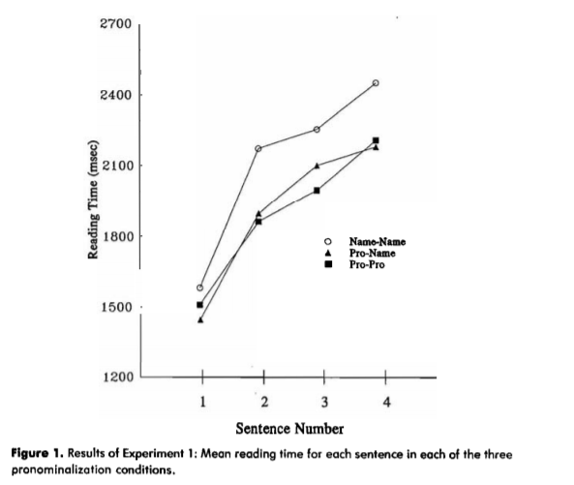
Introduction: Repeated Name Penalty (RNP)
Mean reading time for each sentence
Types of anaphors include pronouns (e.g., he, she, they), and repeated names.
1. Raghav went to the store and he bought some milk.
2. Raghav went to the store and Raghav bought some milk.
Repeated name anaphors = slow comprehension.
This effect on coreference is called the Repeated Name Penalty (RNP) .
Reading Time (ms)
Repeated Name
Pronoun – Name
Pronoun – Pronoun
Sentence Number
(Gordon, Grosz, & Gilliom, 1993)
Introduction
Review of Literature
Hypothesis
Methods
Data and Analysis
Conclusions

Slide 7
The Cause of RNP
Integration
Ambiguity
RNP
Introduction
Review of Literature
Hypothesis
Methods
Data and Analysis
Conclusions

Slide 8
The Cause of RNP
: the process of pairing an anaphor to an object
Integration
?
RNP
Raghav went to the store and Raghav bought some milk.
Ambiguity
: the slow process of understanding
Introduction
Review of Literature
Hypothesis
Methods
Data and Analysis
Conclusions

Slide 9
Objective
The goals of this research were to:
Understand the roles of integration and ambiguity in the Repeated Name Penalty.
Explore the neural mechanisms of coreference using event-related potentials.
Introduction
Review of Literature
Hypothesis
Methods
Data and Analysis
Conclusions

Slide 10
Event-Related Potentials (ERPs)
ERP – a measured brain response that is the direct result of a visual stimulus.
Words on screen as visual stimulus
Reading of words
Electrical activity elicited in the brain is measured with EEG equipment
ERP components are analyzed from the EEG output
Introduction
Review of Literature
Hypothesis
Methods
Data and Analysis
Conclusions

Slide 11
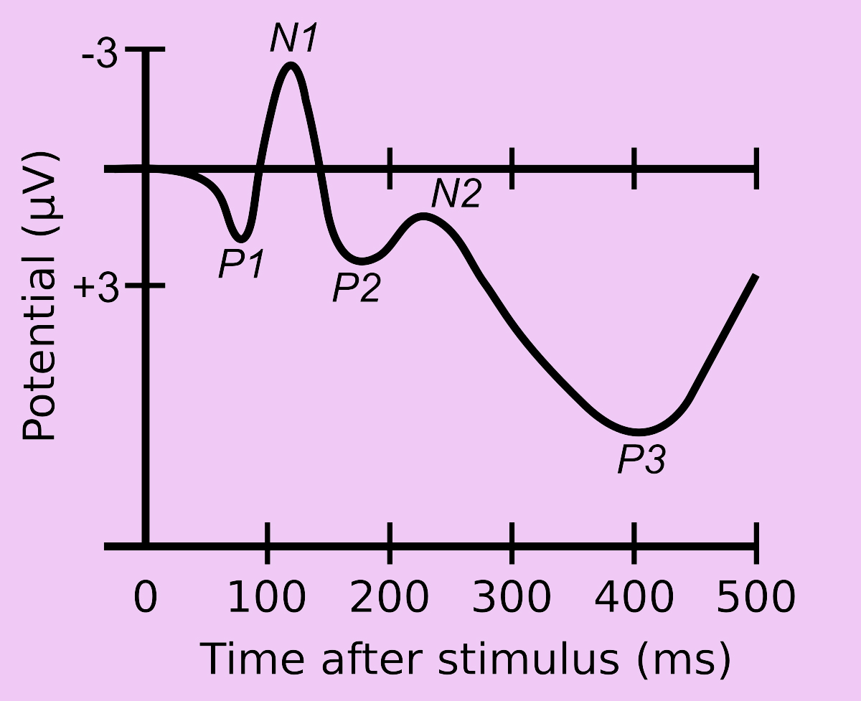
Event-Related Potentials (ERPs)
Two key ERP components have been extensively used to understand the processes involved in coreferential processing:
N400 component
Nref component
Kutas & Hillyard, 1980, Nieuwland & Van Berkum, 2006
Introduction
Review of Literature
Hypothesis
Methods
Data and Analysis
Conclusions

Slide 12
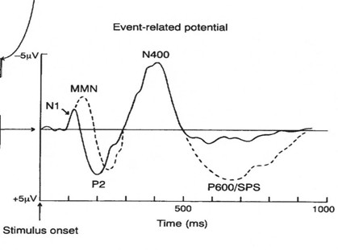
N400 and Nref
Integration
RNP
Boudewyn, M. (2015). Sensitivity to Referential Ambiguity in Discourse: The Role of Attention, Working Memory, and Verbal Ability
Ambiguity
Kutas and Hilyard, 1980
Introduction
Review of Literature
Hypothesis
Methods
Data and Analysis
Conclusions

Slide 13
Hypothesis
(H1) Integration plays a dominant role in the processing cost associated with the Repeated Name Penalty.
(H2) Ambiguity caused by introducing repeated names impedes the integration speed.
Introduction
Review of Literature
Hypothesis
Methods
Data and Analysis
Conclusions

Slide 14
Participants
30 participants (ages 16-24).
Native English speakers.
Two-hour session.
160 sentences, either with repeated names or without.
IRB approval and consent received
Introduction
Review of Literature
Hypothesis
Methods
Data and Analysis
Conclusions

Slide 15
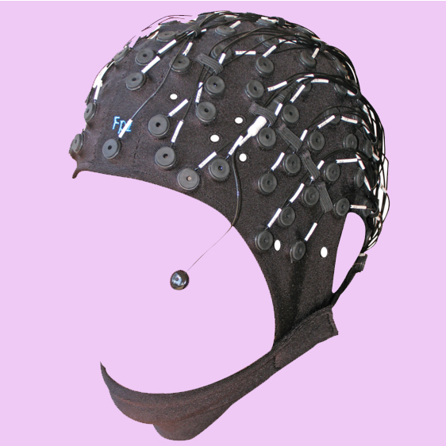
Materials and Methods
EEG
SR Eyelink Eye Tracker
Photo by Raghav Nathan
Photo by Raghav Nathan
Introduction
Review of Literature
Hypothesis
Methods
Data and Analysis
Conclusions

Slide 16
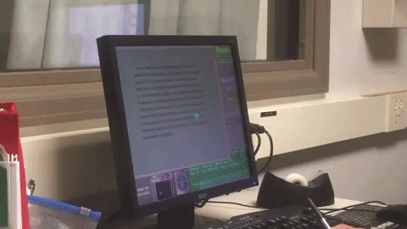
Materials and Methods
The region of interest was comprised of frontal and frontocentral electrodes. This region has previously been associated with the Nref component and the N400 component.
(AFz, AF3, AF4, F1, F2, F3, F4, Fz, FC1, FC2, FC3, FC4, FCz)
The eye tracker monitored the participants’ eye movements during sentence reading. This ensured natural reading instead of guided reading.
Photos by Raghav Nathan
Introduction
Review of Literature
Hypothesis
Methods
Data and Analysis
Conclusions

Slide 17
Results
The areas marked in green show the time recorded for the N400. The dark blue line refers to a sentence that contained a Repeated Name.
There is no sustained negative shift, displaying a lack of an Nref component.
This topographic map shows the peak-areas at the front of the head.
Graphs by Raghav Nathan
Introduction
Review of Literature
Hypothesis
Methods
Data and Analysis
Conclusions

Slide 18
Discussion
The analysis of variance (ANOVA) in the 160 ms – 360 ms window revealed a main effect of Prominence, F = 36.56, p<.0001.
These results are consistent with many previous studies showing this pattern, the electrophysical signature of the repeated-name penalty.
The penalty was present in the regions of interest suggesting that it is broadly distributed, a pattern also present in studies such as those of Johns (2014) and Ledoux (REF).
There was no sustained negative shift elicited, which suggests that the Nref component was absent for this test.
Introduction
Review of Literature
Hypothesis
Methods
Data and Analysis
Conclusions

Slide 19
Conclusions
(H1) Integration plays a dominant role in the processing cost associated with the Repeated Name Penalty.
(H2) Ambiguity does not have a significant impact on the Repeated Name Penalty.
Introduction
Review of Literature
Hypothesis
Methods
Data and Analysis
Conclusions

Slide 20
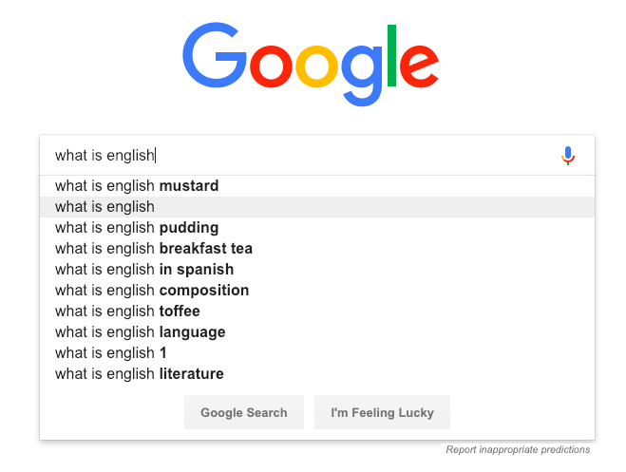
Applications and Future Work
Coreference processing is an area of research in natural language processing in Artificial Intelligence.
This research will help improve natural language processing in AI when responding to emails, displaying search options on google, etc.
Introduction
Review of Literature
Hypothesis
Methods
Data and Analysis
Conclusions

Slide 21
Acknowledgements
Parents
Mentor
Peers
Science Research teacher
Introduction
Review of Literature
Hypothesis
Methods
Data and Analysis
Conclusions

Slide 22
References
Almor, A. (1999). Noun-Phrase Anaphora and Focus: The Informational Load Hypothesis. Psychological Review Vol. 106, No. 4, 748-765
Almor, A. & Nair, V. (2007). The Form of Referential Expressions in Discourse. Language and Linguistics Compass 1/1–2 84–99
Boudewyn, M. (2015). J Cogn Neurosci. 27(12):2309-23
Camblin, C., Ledoux, K., Boudewyn, M., Gordon, P., & Swaab, T. (2007). Processing new and repeated names: Effects of coreference on repetition priming with speech and fast RSVP. Brain Research, 1146, 172–184.
Eilers, S., Tiffin-Richards, S., & Schroeder, S. (2018). The repeated name penalty effect in children’s natural reading: Evidence from eye tracking. Quarterly Journal of Experimental Psychology, 1-10.
Federmeier, K. D., & Kutas, M. (1999). A rose by any other name: Long-term memory structure and sentence processing. Journal of Memory and Language, 41, 469–495.
Gordon, P., Grosz, B., & Gilliom, L. (1993). Pronouns, Names and the Centering of Attention in Discourse. Cognitive Science, 17, 311-347.
Gordon, P. & Hendrick, R. (1998). The Representation and Processing of Coreference in Discourse. Cognitive Science, 22(4), 389-424.

Slide 23
References
Johns, C., Gordon, P., Long, D., & Swaab, T. (2014). Memory availability and referential access. Language, Cognition and Neuroscience, 29(1), 60-87.
Kutas, M., & Hillyard, S. A. (1980). Reading senseless sentences: Brain potentials reflect semantic incongruity. Science, 207, 203–205.
Ledoux, K., Gordon, P., Camblin, C., & Swaab, T. (2007). Coreference and Lexical Repetition: Mechanisms of Discourse Integration, Mem Cognit., 2007 Jun; 35(4): 801–815
Ledoux, K. & Camblin, C. (2008). The Neural Mechanisms of Coreference. Language and Linguistics Compass, 2(6), 1013-1037.
Lezama, C. (2012). A review of the repeated name penalty: implications for null subject languages. Revista LinguíStica, 8(2), 22-34.
Meyer, D. E., & Schvaneveldt, R. W. (1971). Facilitation in recognizing pairs of words: Evidence of a dependency in retrieval operations. Journal of Experimental Psychology, 90, 227–234.
Osterhout, L., Bersick, M., & McKinnon, R. (1997). Brain potentials elicited by words: Word length and frequency predict the latency of an early negativity. Biological Psychology, 46, 143–168.

Slide 24
References
Perfetti, C., Yang, C., & Schmalhofer, F. (2008). Comprehension Skill and Word-to-Text Integration Processes. Applied Cognitive Psychology, 22, 303–318.
Rugg, M. (1985). The Effects of Semantic Priming and Word Repetition on Event‐Related Potentials. Psychophysiology, 22(6), 642-647.
Rugg, M. & Nagy, M. (1987). Lexical contribution to nonword-repetition effects: Evidence from event-related potentials. Memory & Cognition, 15(6), 473–481.
Rugg, M. & Nagy, M. (1989). Event-related potentials and recognition memory for words. Electroencephalography and Clinical Neurophysiology, 72(5), 395-406.
Scarborough, D. L., Cortese, C., & Scarborough, H. S. (1977). Frequency and repetition effects in lexical memory. Journal of Experimental Psychology: Human Perception and Performance, 3, 1–17.
Swaab, T., Camblin, C., & Gordon, P. (2004). Electrophysiological Evidence for Reversed Lexical Repetition Effects in Language Processing. Journal of Cognitive Neuroscience, 16(5), 715–726.

Slide 25
Questions?

