Slide 1
Using an Autonomous Swarm Robot Team to Locate Survivors in a Dangerous Area
By Noah Sanz

Slide 2
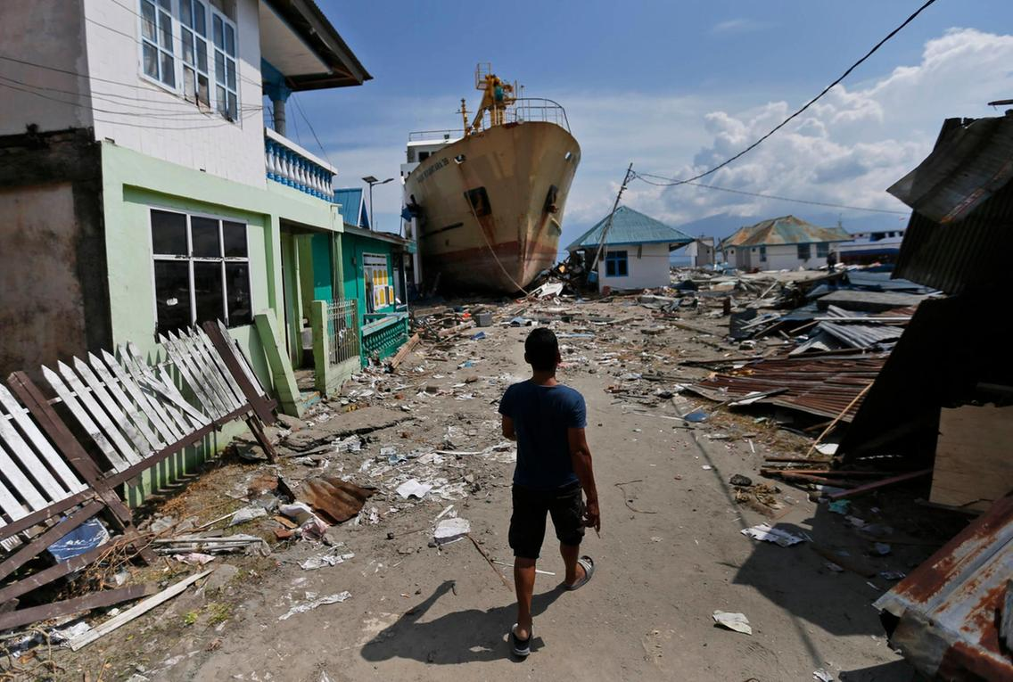
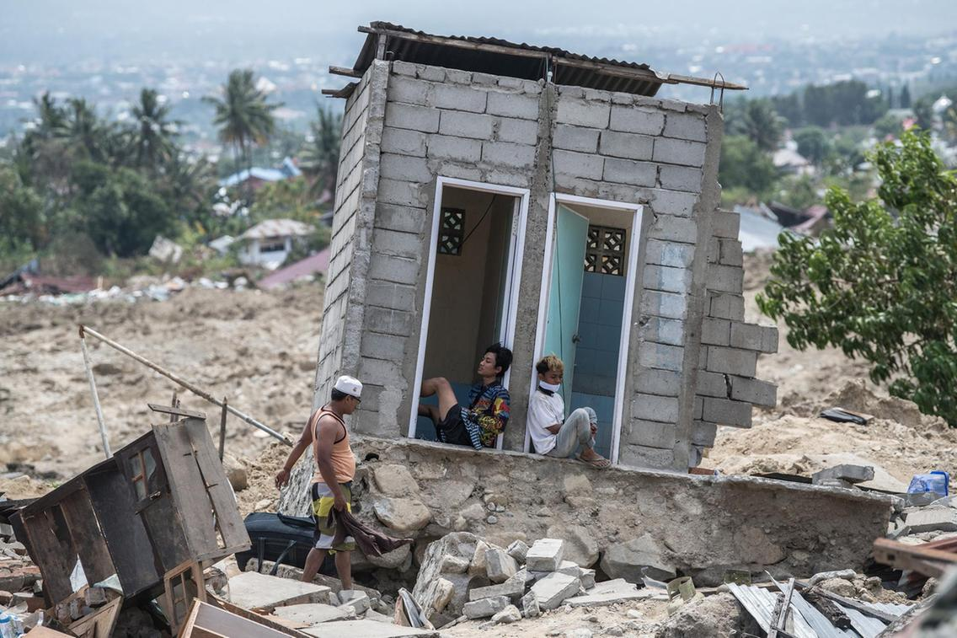
https://www.thenational.ae/world/asia/number-of-missing-soars-one-week-after-earthquake-and-tsunami-on-indonesia-s-sulawesi-island-1.777463#7
http://www.gdacs.org/maps.aspx?eventid=1157757&eventtype=EQ
https://www.thenational.ae/world/asia/number-of-missing-soars-one-week-after-earthquake-and-tsunami-on-indonesia-s-sulawesi-island-1.777463#7

Slide 3
Using an Autonomous Swarm Robot Team to Locate Survivors in a Dangerous Area
By Noah Sanz

Slide 4
What Is Swarm Robotics?
Swarm robotics is a field of study in which a large group of robots is coordinated in a distributed and decentralized way (Navarro & Matia, 2012)
Swarm robot systems are made up of relatively simple robots, and are used to complete complex experiments
Swarm robot systems have many advantages over a single robot
A large number of robots can complete tasks far more efficiently than a single robot
A large group of robots can better adapt to changes in the environment or system
Review of Literature Objectives Methods Results Discussion Conclusion Acknowledgements References

Slide 5
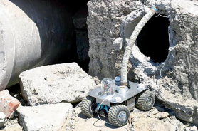
search and rescue with swarm robots
Swarm robots are simple robots that work together to complete more complex tasks
Can search faster than a single robot
Preferable for searching dangerous areas
(Murphy 2008)
Review of Literature Objectives Methods Results Discussion Conclusion Acknowledgements References

Slide 6
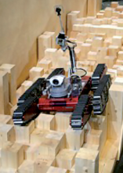
properties of swarm robot systems
Robustness, flexibility, and scalability are important properties for swarm robot systems (Sahin, 2005; Navarro & Matia, 2012; Brambilla, Ferrante, Birattari, & Dirigo, 2013)
Robustness
Ability to compensate
Decentralized control
Flexibility
Adapt to changes in the environment
Scalability
Ability to operate under a wide range of group sizes
(Murphy 2008)
Review of Literature Objectives Methods Results Discussion Conclusion Acknowledgements References

Slide 7
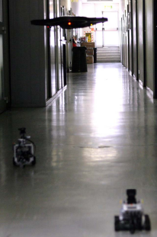
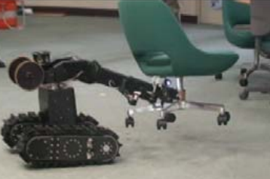
Past Swarm robot systems
The HELIOS system (Guarnieri et al., 2009) and the Multi-Robot Search and Rescue Team (Luo, Espinosa, Pranantha, & De Gloria 2011) are examples of swarm robot teams that are used for search and rescue
Robot System | HELIOS | Multi-Robot Search and Rescue Team
Able to search unknown environment
Low cost and expendable
Autonomous
(Guarnieri et al., 2009)
(Luo, Espinosa, Pranantha, & De Gloria 2011)
Review of Literature Objectives Methods Results Discussion Conclusion Acknowledgements References

Slide 8
The HELIOS system
The HELIOS system was an early swarm robot system for search and rescue (Guarnieri et al., 2009).
The HELIOS system was successfully able to search an environment, and was even able to lift objects and open doors, tasks of which few swarm robots are capable.
The mechanical components of the robots were expensive, meaning the robots were not expendable.
The biggest disadvantage of the HELIOS System is the lack of autonomy.
This requires multiple operators to control the robots during a search and rescue mission.
(Guarnieri et al., 2009)
Review of Literature Objectives Methods Results Discussion Conclusion Acknowledgements References

Slide 9
Multi-Robot Search and Rescue Team
A few years later, the Multi-Robot Search and Rescue Team was created (Luo, Espinosa, Pranantha, & De Gloria 2011) .
This team of robots consisted of both air and ground units.
Multi-Robot Search and Rescue Team was controlled autonomously.
These robots were smaller and less expensive than the HELIOS robots
They were still not expendable because they required the use of drones and object detection cameras.
(Luo, Espinosa, Pranantha, & De Gloria 2011)
Review of Literature Objectives Methods Results Discussion Conclusion Acknowledgements References

Slide 10
Objectives
Create and test a simple and low-cost swarm robot system that is capable of searching an unknown environment for human life without any external assistance
Have the system be able to search 1m² in 60s or less
Have the system achieve at least 90% efficiency
$$E=\frac{t_{s}}{t_{m}×n}×100\%$$
E
t_{s}
t_{m}
n
= Efficiency
= The time it takes a single robot to locate the human
= The time it takes a team of robots to locate the human
= The number of robots in the team
Review of Literature Objectives Methods Results Discussion Conclusion Acknowledgements References

Slide 11
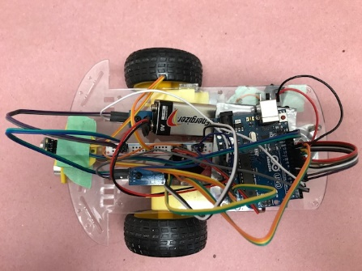
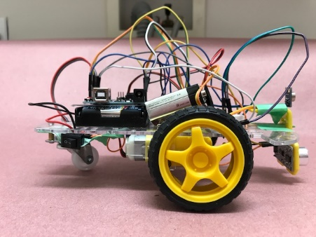
The Hardware: The body
Image by Noah Sanz
Image by Noah Sanz
Review of Literature Objectives Methods Results Discussion Conclusion Acknowledgements References
Notes:
The body of the robot housed an onboard control center, communication system, motors, and power supply, as well as most of the wiring.
The power supply, a 9V battery and four AA batteries, was used to power the onboard control center, an Arduino Uno.
The Arduino Uno controlled the radio transceiver and allowed the robot to communicate with the central control system.
Additionally, the Arduino Uno controlled the motors and sensors.
Two DC motors were used to control the wheels of the robot.
The body and the sensor panel were made out of plastic.

Slide 12
The Hardware: The Sensor panel
Ultrasonic sensor
Used for obstacle detection
Range of 400mm
Infrared temperature sensor
Used to detect the temperature of an object
Range of 20mm for exact reading
Range of 60mm to detect changes in temperature
Image by Noah Sanz
Review of Literature Objectives Methods Results Discussion Conclusion Acknowledgements References

Slide 13
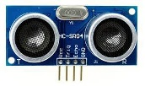
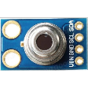
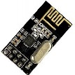
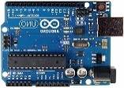
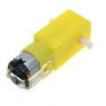
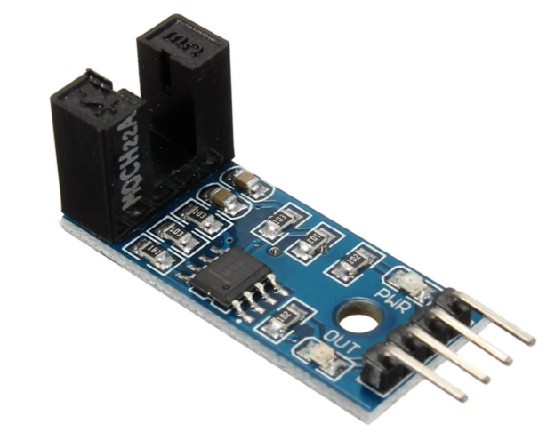
The Hardware: The components
Name | Ultrasonic Sensor | IR Temp. Sensor | Radio Transceivers | Arduino Uno | DC Gear Motor | Speed Sensor
Picture
Approximate Dimensions (mm) | 45 x 20 x 15 | 11 x 17 x 6 | 29 x 15 x5 | 69 x 53 x 5 | 70 x 22 x 9 | 30 x 14 x 12
Cost | $1.60 | $9.99 | $1.20 | $8.99 | $2.99 (x2) | $1.34 (x2)
Range (mm) | 400 | 60 | 100,000 | NA | NA | NA
Review of Literature Objectives Methods Results Discussion Conclusion Acknowledgements References

Slide 14
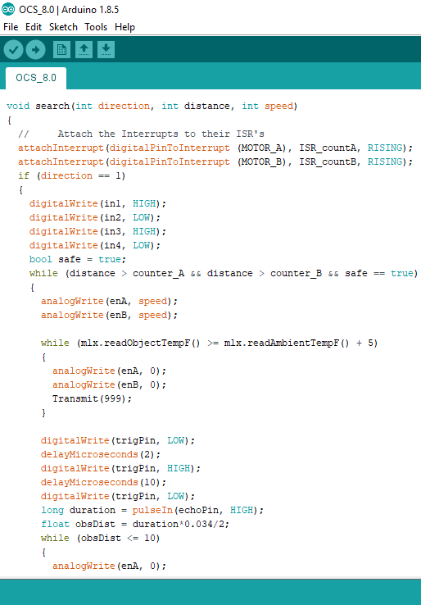
The control system
The control system for the robot consists of two parts: the Central Control System (CCS) and the Onboard Control System (OCS)
The CCS is the interface between the user and the robots
The CCS supervises all of the robots in the system
The OCS controls the robots movement, sensing, and communication with the CCS
The OCS determines the path to drive the robot in and scans for obstacles or humans
Image by Noah Sanz
Review of Literature Objectives Methods Results Discussion Conclusion Acknowledgements References

Slide 15
The control system
Setup
Execution
User
Enter information –
Number of robots, position of robots, & size of area to search
Receives alert
CCS
Message each robot – Begin searching the area
Message each robot – Check robots progress
Y
Response received?
N
Message each robot – Robot A was damaged at position (x, y)
Alert the user
Receive information
OCS
Receive message
Sends response
Receive message
Human found?
Search in a random pattern
Alert the CCS
Y
N
Review of Literature Objectives Methods Results Discussion Conclusion Acknowledgements References

Slide 16
Obstacle Detection
As the robot approaches an obstacle it
Detects it
Turns away from the obstacle and
Drives away
Video by Noah Sanz
Review of Literature Objectives Methods Results Discussion Conclusion Acknowledgements References

Slide 17
Human detection
As the robot approaches a human it
Detects it,
Moves closer,
Determines if it’s a human,
Stops, and
Sends a message to the CCS
Review of Literature Objectives Methods Results Discussion Conclusion Acknowledgements References

Slide 18
testing
Six tests were carried out to examine the systems ability.
During all six experiments the room size and shape were held constant as a 2.5m by 2m rectangle, as was the number and size of the obstacles and humans present.
Half of the tests were carried out with a single robot and half were carried out with a swarm of two robots.
Each experiment was carried out three times for replicate data and the completion times were recorded.
The completion time is the amount of time that the robot or robots took to locate the human.
If the robots search the entire environment without finding the human, the test is recorded as a failure.
Review of Literature Objectives Methods Results Discussion Conclusion Acknowledgements References

Slide 19
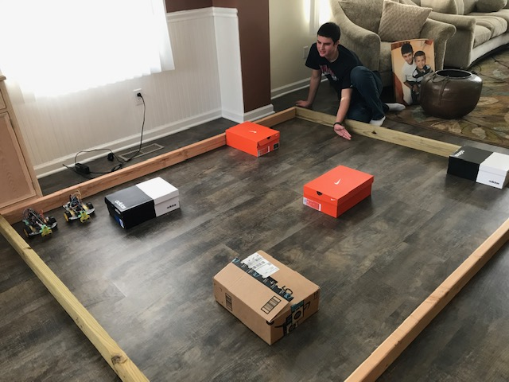
Testing Environment
Images by Noah Sanz
Review of Literature Objectives Methods Results Discussion Conclusion Acknowledgements References

Slide 20
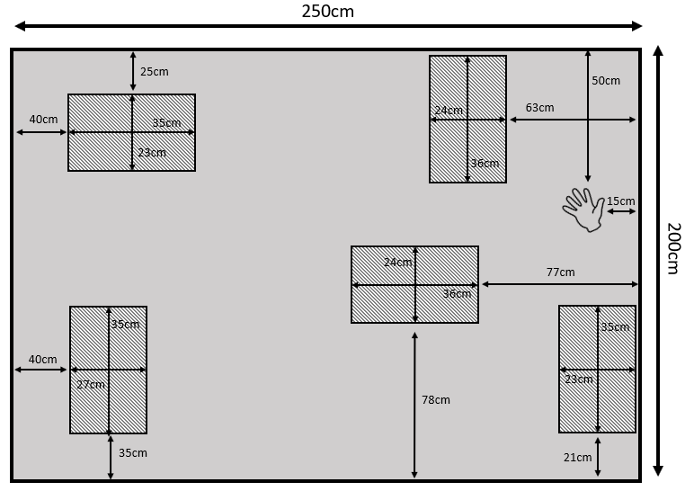
Testing environment
Review of Literature Objectives Methods Results Discussion Conclusion Acknowledgements References

Slide 21
Results
Size of swarm | 1 robot | 2 robots
Trial 1 | 220 seconds | 110 seconds
Trial 2 | 141 seconds | 57 seconds
Trial 3 | 135 seconds | Failure
Average | 165.3 seconds | 83.5 seconds
Efficiency | 98.98%
Review of Literature Objectives Methods Results Discussion Conclusion Acknowledgements References

Slide 22
Discussion
Create and test a simple and low-cost swarm robot system that is capable of searching an unknown environment for human life without any external assistance.
Have the system be able to search 1m² in 60s or less.
Have the system achieve at least 90% efficiency.
$$E=\frac{t_{s}}{t_{m}×n}×100\%$$
Review of Literature Objectives Methods Results Discussion Conclusion Acknowledgements References

Slide 23
Discussion
Low cost (Under $40)
98.98% Efficiency
System can adapt to different group sizes
The system is scalable
The robots are more expendable
Preferable for dangerous environments
Review of Literature Objectives Methods Results Discussion Conclusion Acknowledgements References

Slide 24
Discussion
The use of dead reckoning is a low-cost way to determine position, but it has limitations
Dead reckoning is subject to more error than other positioning methods especially when using DC motors to drive the robot
It is also inaccurate on uneven ground
A second limitation is the use of an infrared thermal sensor to detect humans
While it is a low cost and simple replacement for high-tech cameras, it is unable to determine the difference between a human and another hot object
Review of Literature Objectives Methods Results Discussion Conclusion Acknowledgements References

Slide 25
Conclusion
In conclusion, I was successfully able to create a low-cost simple robot system capable of searching an unknown environment for human life
Additionally, the system was able to achieve its efficiency and speed goals
Future research will focus on a more accurate positioning system that is low cost and capable of working indoors
It will also focus on development of a simulator to discover better search processes
Review of Literature Objectives Methods Results Discussion Conclusion Acknowledgements References

Slide 26
Acknowledgement
My computer science teacher
My engineering teacher
My science research teacher
My parents
Review of Literature Objectives Methods Results Discussion Conclusion Acknowledgements References

Slide 27
References
Navarro, I., Matia, F. (2012). An Introduction to Swarm Robotics. Hindawi Publishing Corporation,
Sahin, E. (2005). Swarm Robotics: From Sources of Inspiration to Domains of Application. Middle Eastern Technical University,
Brambilla, M., Ferrante, E., Birattari, M., Dirigo, M. (2013). Swarm robotics: A review from the swarm engineering perspective. HAL archives, 7(1), 1-36.
Guarnieri M., Kurazume R., Masuda H., Inoh T., Takita K., Debenest P., Hodoshima R., Fukushima E., Hirose S. (2009). HELIOS System: A Team of Tracked Robots for Special Urban Search and Rescue Operations. IEEE/RSJ International Conference on Intelligent Robots and Systems,
Luo, C., Espinosa, A. P., Pranantha, D., & De Gloria, A. (2011, November). Multi-robot search and rescue team. In Safety, Security, and Rescue Robotics (SSRR), 2011 IEEE International Symposium on (pp. 296-301). IEEE.
Murphy, Robin R., et al. "Search and rescue robotics." Springer handbook of robotics. Springer, Berlin, Heidelberg, 2008. 1151-1173.
Review of Literature Objectives Methods Results Discussion Conclusion Acknowledgements References

